Slide 1
dup() and friends

Slide 2
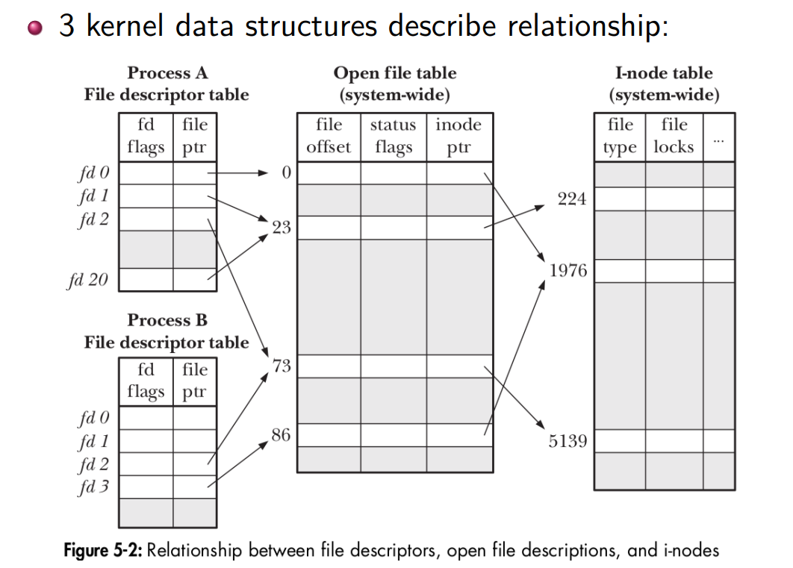
File Descriptors in Linux

Slide 3
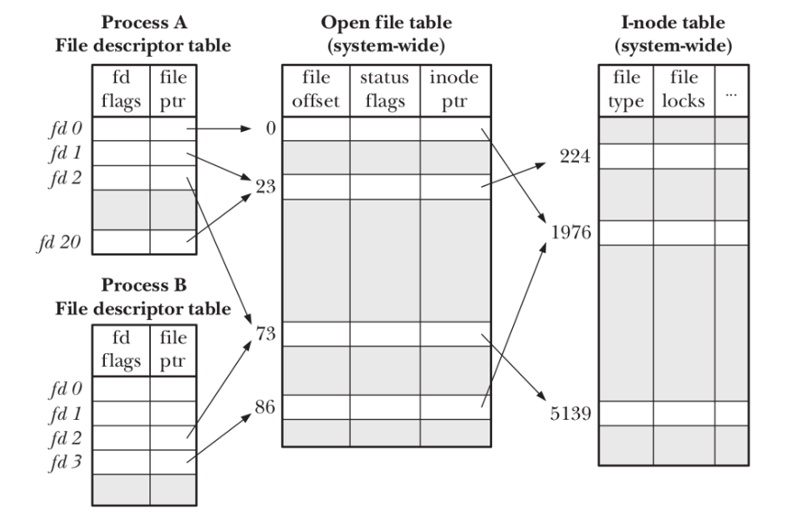
File descriptor table
Per-process table with one entry for each FD opened by process:
Located in Process control block (PCB)
Flags controlling operation of FD (close-on-exec flag)
Reference to open file description
struct fdtable in include/linux/fdtable.h

Slide 4
Table of open file descriptions (open file table)
System-wide table, one entry for each open file on system:
File offset
File access mode (R / W / R-W, from open())
File status flags (from open())
Reference to inode object for file
struct file in include/linux/fs.h

Slide 5
(In-memory) inode table
System-wide table drawn from file inode information in filesystem:
File type (regular file, FIFO, socket, . . . )
File permissions
Other file properties (size, timestamps, . . . )
struct inode in include/linux/fs.h

Slide 6
struct file
.f_path = "/dev/tty0",
.f_flags = O_RDONLY | ...,
.f_inode = ...,
struct inode
struct fdtable
...
.i_mode = 0620,
.i_uid = ...,
.i_gid = ...,
flags file table entry ptr
flags file table entry ptr
flags file table entry ptr
flags file table entry ptr
flags file table entry ptr
... ...
.f_path = "/dev/tty0",
.f_flags = O_WRONLY | ...,
.f_inode = ...,
.f_path = "/tmp/file.txt",
.f_flags = O_WRONLY | ...,
.f_inode = ...,
.i_mode = 0664,
.i_uid = ...,
.i_gid = ...,
...
PCB

Slide 7
How does the OS track file descriptors?
File descriptors are process-specific
Tracked in PCB, in an array mapping fds to {flags, file table entry pointer}s
File table entries track flconceptually, an open file)
Flags for the file, the current position in the file, and a pointer to the corresponding inode
inode represents filesystem entry directly
struct file
.f_path = "/dev/tty0",
.f_flags = O_RDONLY | ...,
.f_inode = ...,
struct inode
PCB
...
.i_mode = 0620,
.i_uid = ...,
.i_gid = ...,
fd_table[0]
fd_table[1]
fd_table[2]
fd_table[3]
fd_table[4]
...
flags file table entry ptr
flags file table entry ptr
flags file table entry ptr
flags file table entry ptr
flags file table entry ptr
... ...
.f_path = "/dev/tty0",
.f_flags = O_WRONLY | ...,
.f_inode = ...,
.f_path = "/tmp/file.txt",
.f_flags = O_WRONLY | ...,
.f_inode = ...,
.i_mode = 0664,
.i_uid = ...,
.i_gid = ...,
...

Slide 8
How can a process change the file table in its PCB?
Remember that we don't have direct access to our PCB, and that we must ask the kernel to read/modify it thru system calls.
fd = open(path, flags, mode) - allocate a new "struct file" in the kernel & make a new file descriptor for our process which points to it.
close(fd) - remove the entry corresponding to fd in our table, if no pointers left to the "struct file", the kernel will free the "struct file" as well
dup(fd) - create a new file descriptor in our table, which is an exact copy of fd from our table. fd passed to the function and the returned fd will point to the same "struct file" after this operation.
dup2(fd1, fd2) - the entry at fd2 in our PCB will be overwritten with the contents at fd1, so that fd1 and fd2 now both point to the same "struct file"

Slide 9
Example: open("/tmp/file.txt", O_WRONLY | O_CREAT | O_TRUNC, 0664)
BEFORE
struct file
.f_path = "/dev/tty0",
.f_flags = O_RDONLY | ...,
.f_inode = ...,
struct inode
PCB
...
.i_mode = 0620,
.i_uid = ...,
.i_gid = ...,
fd_table[0]
fd_table[1]
fd_table[2]
fd_table[3]...
flags file table entry ptr
flags file table entry ptr
flags file table entry ptr
NULL NULL
... ...
.f_path = "/dev/tty0",
.f_flags = O_WRONLY | ...,
.f_inode = ...,
...

Slide 10
Example: open("/tmp/file.txt", O_WRONLY | O_CREAT | O_TRUNC, 0664)
AFTER
struct file
.f_path = "/dev/tty0",
.f_flags = O_RDONLY | ...,
.f_inode = ...,
struct inode
PCB
...
.i_mode = 0620,
.i_uid = ...,
.i_gid = ...,
fd_table[0]
fd_table[1]
fd_table[2]
fd_table[3]...
flags file table entry ptr
flags file table entry ptr
flags file table entry ptr
flags file table entry ptr
NULL NULL
... ...
.f_path = "/dev/tty0",
.f_flags = O_WRONLY | ...,
.f_inode = ...,
.f_path = "/tmp/file.txt",
.f_flags = O_WRONLY | ...,
.f_inode = ...,
.i_mode = 0664,
.i_uid = ...,
.i_gid = ...,
...

Slide 11
Example: close(3)
BEFORE
struct file
.f_path = "/dev/tty0",
.f_flags = O_RDONLY | ...,
.f_inode = ...,
struct inode
PCB
...
.i_mode = 0620,
.i_uid = ...,
.i_gid = ...,
fd_table[0]
fd_table[1]
fd_table[2]
fd_table[3]...
flags file table entry ptr
flags file table entry ptr
flags file table entry ptr
flags file table entry ptr
NULL NULL
... ...
.f_path = "/dev/tty0",
.f_flags = O_WRONLY | ...,
.f_inode = ...,
.f_path = "/tmp/file.txt",
.f_flags = O_WRONLY | ...,
.f_inode = ...,
.i_mode = 0664,
.i_uid = ...,
.i_gid = ...,
...

Slide 12
Example: close(3)
AFTER
struct file
.f_path = "/dev/tty0",
.f_flags = O_RDONLY | ...,
.f_inode = ...,
struct inode
PCB
...
.i_mode = 0620,
.i_uid = ...,
.i_gid = ...,
fd_table[0]
fd_table[1]
fd_table[2]
fd_table[3]...
flags file table entry ptr
flags file table entry ptr
flags file table entry ptr
NULL NULL
... ...
.f_path = "/dev/tty0",
.f_flags = O_WRONLY | ...,
.f_inode = ...,
...

Slide 13
Example: dup(3)
BEFORE
struct file
.f_path = "/dev/tty0",
.f_flags = O_RDONLY | ...,
.f_inode = ...,
struct inode
PCB
...
.i_mode = 0620,
.i_uid = ...,
.i_gid = ...,
fd_table[0]
fd_table[1]
fd_table[2]
fd_table[3]...
flags file table entry ptr
flags file table entry ptr
flags file table entry ptr
flags file table entry ptr
NULL NULL
... ...
.f_path = "/dev/tty0",
.f_flags = O_WRONLY | ...,
.f_inode = ...,
.f_path = "/tmp/file.txt",
.f_flags = O_WRONLY | ...,
.f_inode = ...,
.i_mode = 0664,
.i_uid = ...,
.i_gid = ...,
...

Slide 14
Example: dup(3) - returns 4
AFTER
struct file
.f_path = "/dev/tty0",
.f_flags = O_RDONLY | ...,
.f_inode = ...,
struct inode
PCB
...
.i_mode = 0620,
.i_uid = ...,
.i_gid = ...,
fd_table[0]
fd_table[1]
fd_table[2]
fd_table[3]
fd_table[4]
...
flags file table entry ptr
flags file table entry ptr
flags file table entry ptr
flags file table entry ptr
flags file table entry ptr
NULL NULL
... ...
.f_path = "/dev/tty0",
.f_flags = O_WRONLY | ...,
.f_inode = ...,
.f_path = "/tmp/file.txt",
.f_flags = O_WRONLY | ...,
.f_inode = ...,
.i_mode = 0664,
.i_uid = ...,
.i_gid = ...,
...

Slide 15
Example: dup2(3, 1)
BEFORE
struct file
.f_path = "/dev/tty0",
.f_flags = O_RDONLY | ...,
.f_inode = ...,
struct inode
PCB
...
.i_mode = 0620,
.i_uid = ...,
.i_gid = ...,
fd_table[0]
fd_table[1]
fd_table[2]
fd_table[3]...
flags file table entry ptr
flags file table entry ptr
flags file table entry ptr
flags file table entry ptr
NULL NULL
... ...
.f_path = "/dev/tty0",
.f_flags = O_WRONLY | ...,
.f_inode = ...,
.f_path = "/tmp/file.txt",
.f_flags = O_WRONLY | ...,
.f_inode = ...,
.i_mode = 0664,
.i_uid = ...,
.i_gid = ...,
...

Slide 16
Example: dup2(3, 1)
AFTER
struct file
.f_path = "/dev/tty0",
.f_flags = O_RDONLY | ...,
.f_inode = ...,
struct inode
PCB
...
.i_mode = 0620,
.i_uid = ...,
.i_gid = ...,
fd_table[0]
fd_table[1]
fd_table[2]
fd_table[3]...
flags file table entry ptr
flags file table entry ptr
flags file table entry ptr
flags file table entry ptr
NULL NULL
... ...
.f_path = "/dev/tty0",
.f_flags = O_WRONLY | ...,
.f_inode = ...,
.f_path = "/tmp/file.txt",
.f_flags = O_WRONLY | ...,
.f_inode = ...,
.i_mode = 0664,
.i_uid = ...,
.i_gid = ...,
...

Slide 17
The syscalls you need for P2#D2
File Redirection
open() - to open the input and output files
dup2() - to point stdin/stdout to the file descriptors you've opened
Piping
pipe() - to create new pipes in the parent shell process
dup2() - to point stdin/stdout to the read/write end of the pipes you've made
close() - to close the read end of the pipe in the child process (for piping out), and to close the read/write end of the pipe in the parent process

Slide 18
Recommended flow for file redirect
(Option A: open in parent process)
Parent
fd = open(...)
fork()
close(fd)
waitpid()
Child
dup2(fd, ...)
exec()

Slide 19
Recommended flow for file redirect
(Option B: open in child process)
Parent
fork()
waitpid()
Child
fd = open(...)
dup2(fd, ...)
exec()

Slide 20
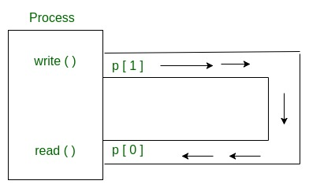
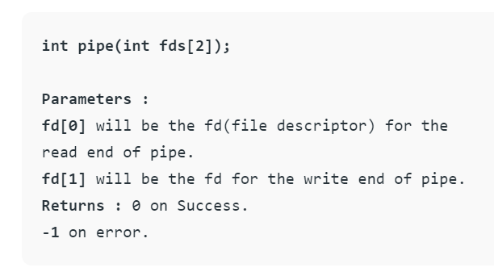
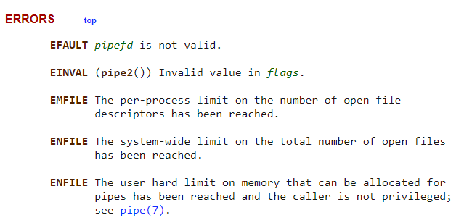
Pipe System Call

Slide 21
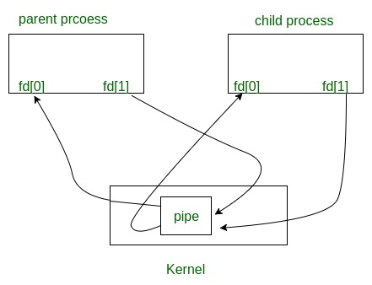


Parent and Child Sharing a Pipe
When we use fork in any process, file descriptors remain open across child process and also parent process. If we call fork after creating a pipe, then the parent and child can communicate via the pipe.

Slide 22
1 Recommended flow for piping into another command
Parent
pipe(pipefd)
fork()
close(pipefd[1])
waitpid()
Child
close(pipefd[0])
dup2(pipefd[1], STDOUT_FILENO)
exec()

Slide 23
2 Recommended flow for receiving pipe from previous command in pipeline
Parent
(pipefd exists from previous command)
fork()
close(pipefd[0])
waitpid()
Note: we don't want to close pipefd[1] at this point, as it was already closed in parent process
Child
dup2(pipefd[0], STDIN_FILENO)
exec()

Slide 24
Combining it all together
Think about how to handle commands which have both a pipe input and a pipe output (Hint: we need to keep track of two pipefd arrays, one for input, one for output)
Keep in mind that an input file can appear in the first command of a pipeline, and an output file on the last command of a pipeline
For a pipeline of length 1 (single command), we can have both an input and output file, potentially
Try it: writing pseudocode before real C can be an effective strategy to comprehend this problem.

